Slide 1
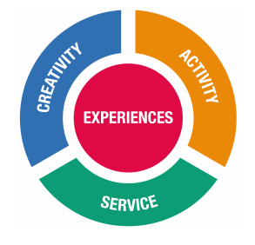
Creativity, Activity, Service (CAS)
One of the core requirements of the IB Diploma Program (along with ToK and the EE)
Provides an opportunity for students to serve their communities and reflect on WHY they did it: meaningful connections
IB CAS is organized around three strands:
Creativity—exploring and extending ideas leading to an original or interpretive product or performance
Activity—physical exertion contributing to a healthy lifestyle
Service—collaborative and reciprocal engagement with the community in response to an authentic need

Slide 2
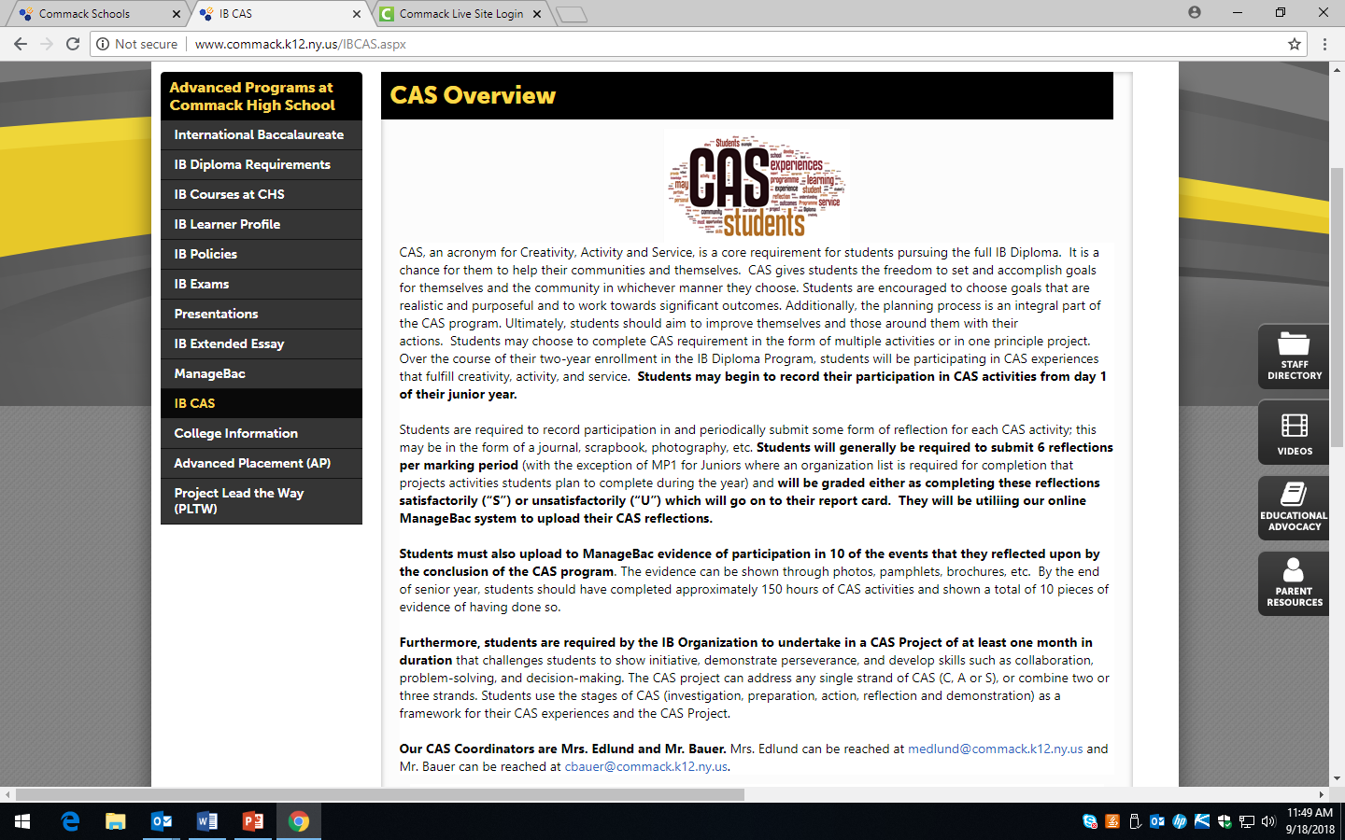
eSchoolview Page for CAS: Commack High School>Academic Programs
>Advanced Programs at Commack High School>International Baccalaurate>IB CAS

Slide 3
Important CAS Information
When does IB CAS begin and end?
CAS begins: first day of Junior year
CAS Ends: after Marking Period 3 of Senior year
What do I have to do for CAS?
Record reflections as a journal entry- each marking period based on a CAS experience that you have participated in.
Submit evidence for each reflection. (picture, certificate, etc.)
Students submit 8 reflections and 8 pieces of evidence showing proof of participation at the conclusion of the CAS Program (over the course of 2 years).
Participate in a group service project that we will address at an later in the school year.

Slide 4
What else do I need to know about IB CAS?
Your CAS reflections must:
fit within one or more of the CAS strands (C-A-S).
be based on a personal interest, skill, talent or opportunity for growth. Examples: Marching Band, Sports Teams, Clubs, Volunteering, etc.
not involve activities where you preach/teach your faith or speak about your religious beliefs. You may perform service through your religious institution (soup kitchens, carnivals, clothing drives, etc.).

Slide 5
What else do I need to know about IB CAS?
Your CAS reflections must:
address each of the 7 CAS Learning Outcomes over two years.
(7 marking periods= 7 reflections= 7 learning outcomes)
CAS Learning Outcomes: show what a CAS student can do at different points during his or her CAS program.
So what are these CAS Learning Outcomes?

Slide 6
Seven CAS Learning Outcomes
1: Identify own strengths and develop areas for growth
Students are able to see themselves as individuals with various abilities and skills, of which some are more developed than others.
2: Demonstrate that challenges have been undertaken, developing new skills in the process
A new challenge may be an unfamiliar experience or an extension of an existing one. The newly acquired or developed skills may be shown through experiences that the student has not previously undertaken or through increased expertise in an established area.
3: Demonstrate how to initiate and plan a CAS experience
Students can articulate the stages from conceiving an idea to executing a plan for a CAS experience or series of CAS experiences. This may be accomplished in collaboration with other participants. Students may show their knowledge and awareness by building on a previous experience, or by launching a new idea or process.
4: Show commitment to and perseverance in CAS experiences
Students demonstrate regular involvement and active engagement in CAS.
5: Demonstrate the skills and recognize the benefits of working collaboratively
Students are able to identify, demonstrate and critically discuss the benefits and challenges of collaboration gained through CAS experiences.
6: Demonstrate engagement with issues of global significance
Students are able to identify and demonstrate their understanding of global issues, make responsible decisions, and take appropriate action in response to the issue either locally, nationally or internationally.
7: Recognize and consider the ethics of choices and actions
Students show awareness of the consequences of choices and actions in planning and carrying out CAS experiences.

Slide 7
What else do I need to know about IB CAS?
Your CAS reflections must:
be uploaded to your ManageBac account.
ManageBac
Everything submitted for CAS is done through ManageBac, including: creating your list of CAS experiences, reflection submissions, evidence submissions, planning your CAS project, contacting your advisors, checking deadlines, etc.
Should have already received an email to set up your account.
Watch the ManageBac tutorials on the IB Eschoolview page.
Download the app on your phone, you can add your submissions straight from your phone!

Slide 8
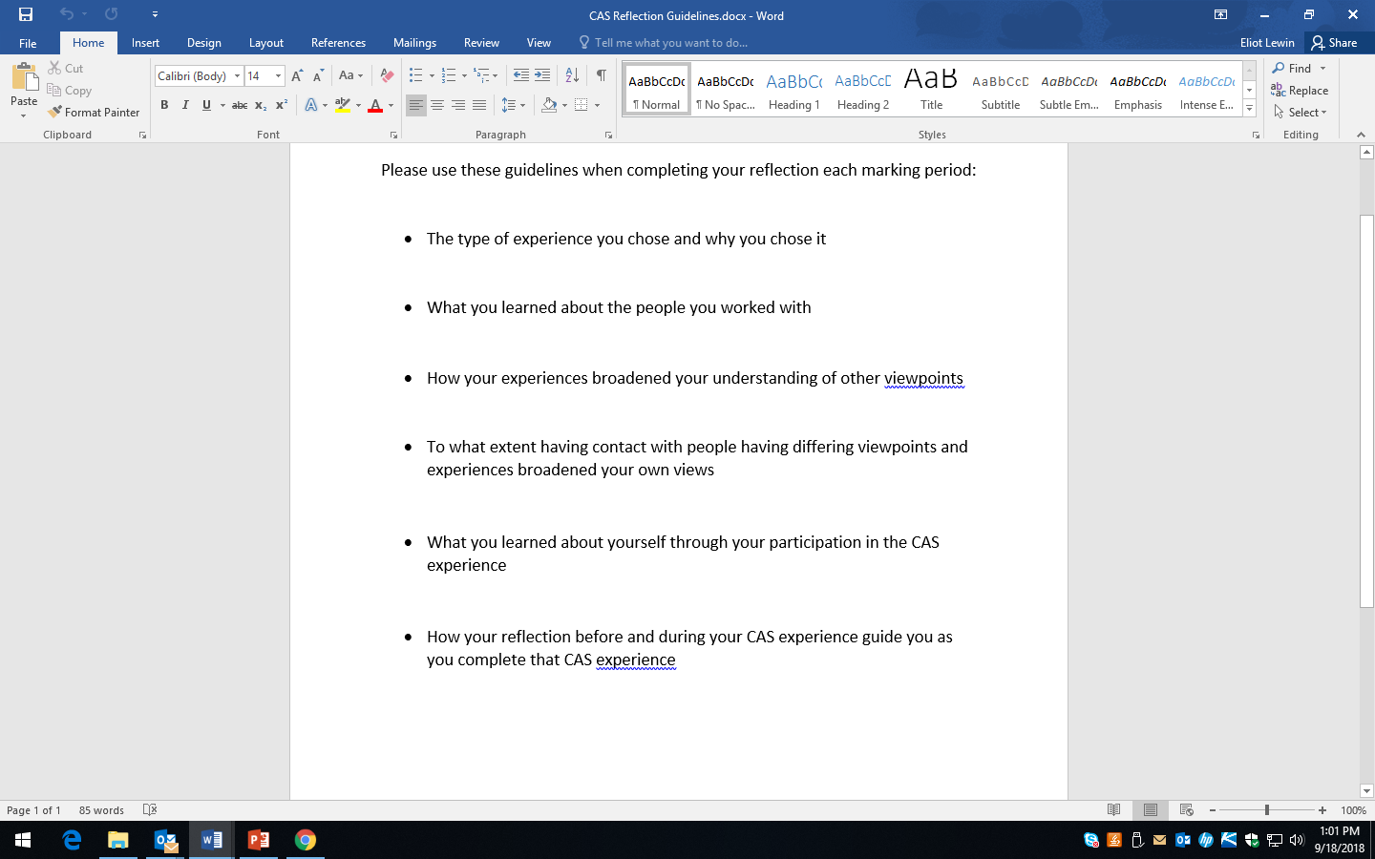
Reflection Guidelines for Each Marking Period
These Reflection
Guidelines will be posted on the IB CAS ESV page!

Slide 9
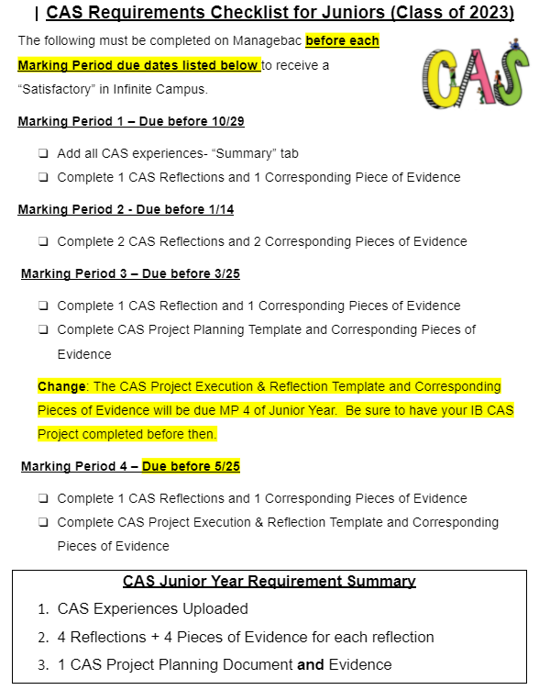
Important CAS Dates for Juniors
This CAS Requirements Checklist will be posted on the IB CAS ESV page!

Slide 10
First Deadline: Creating your List of CAS Experiences
In ManageBac:
On the left tab select IB Manager then select CAS.
At the top right will be a button that says add CAS Experience.
This is how you will create your list of CAS Experiences for your first deadline.
Fill in the form that will lead you through a series of questions about each CAS experience.
The description is from 1-2 sentences and should be used as a starting point for a future reflection, so the more descriptive you are now the easier writing your reflection will be.
When you have completed each CAS experience to add reflections and evidence, click on the specific CAS experience and you will see at the top a tab that says Add Reflections and Evidence.

Slide 11
Communication
Please email me at: jzaidinski@Commack.k12.ny.us
Message me through google classroom
Message me through your ManageBac account
Subrscribe to Remind
I’m here for you!

